Slide 1
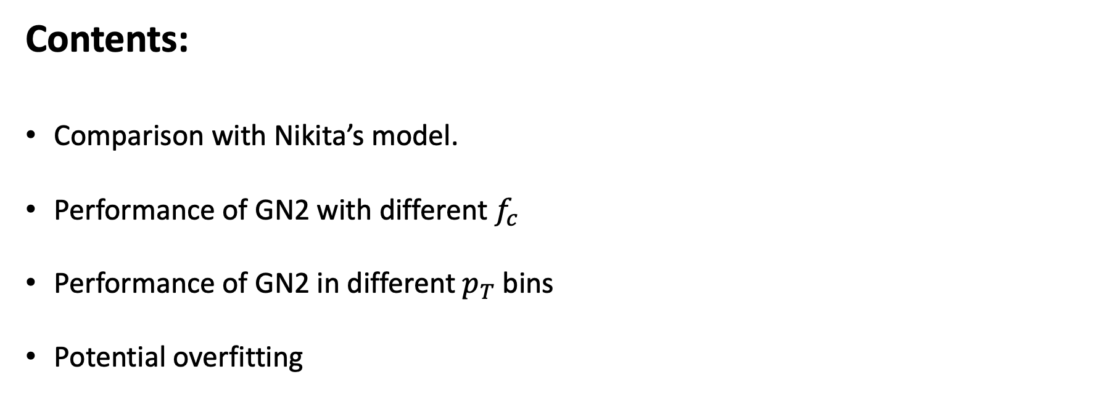
MSc Project Weekly Update (1st Dec)
Ruben Hönscheid | Supervisor: Prof. Tim Scanlon
Contents:
Comparison with Nikita’s model.
Performance of GN2 with different $f_{c}$
Performance of GN2 in different $p_{T}$ bins
Potential overfitting

Slide 2
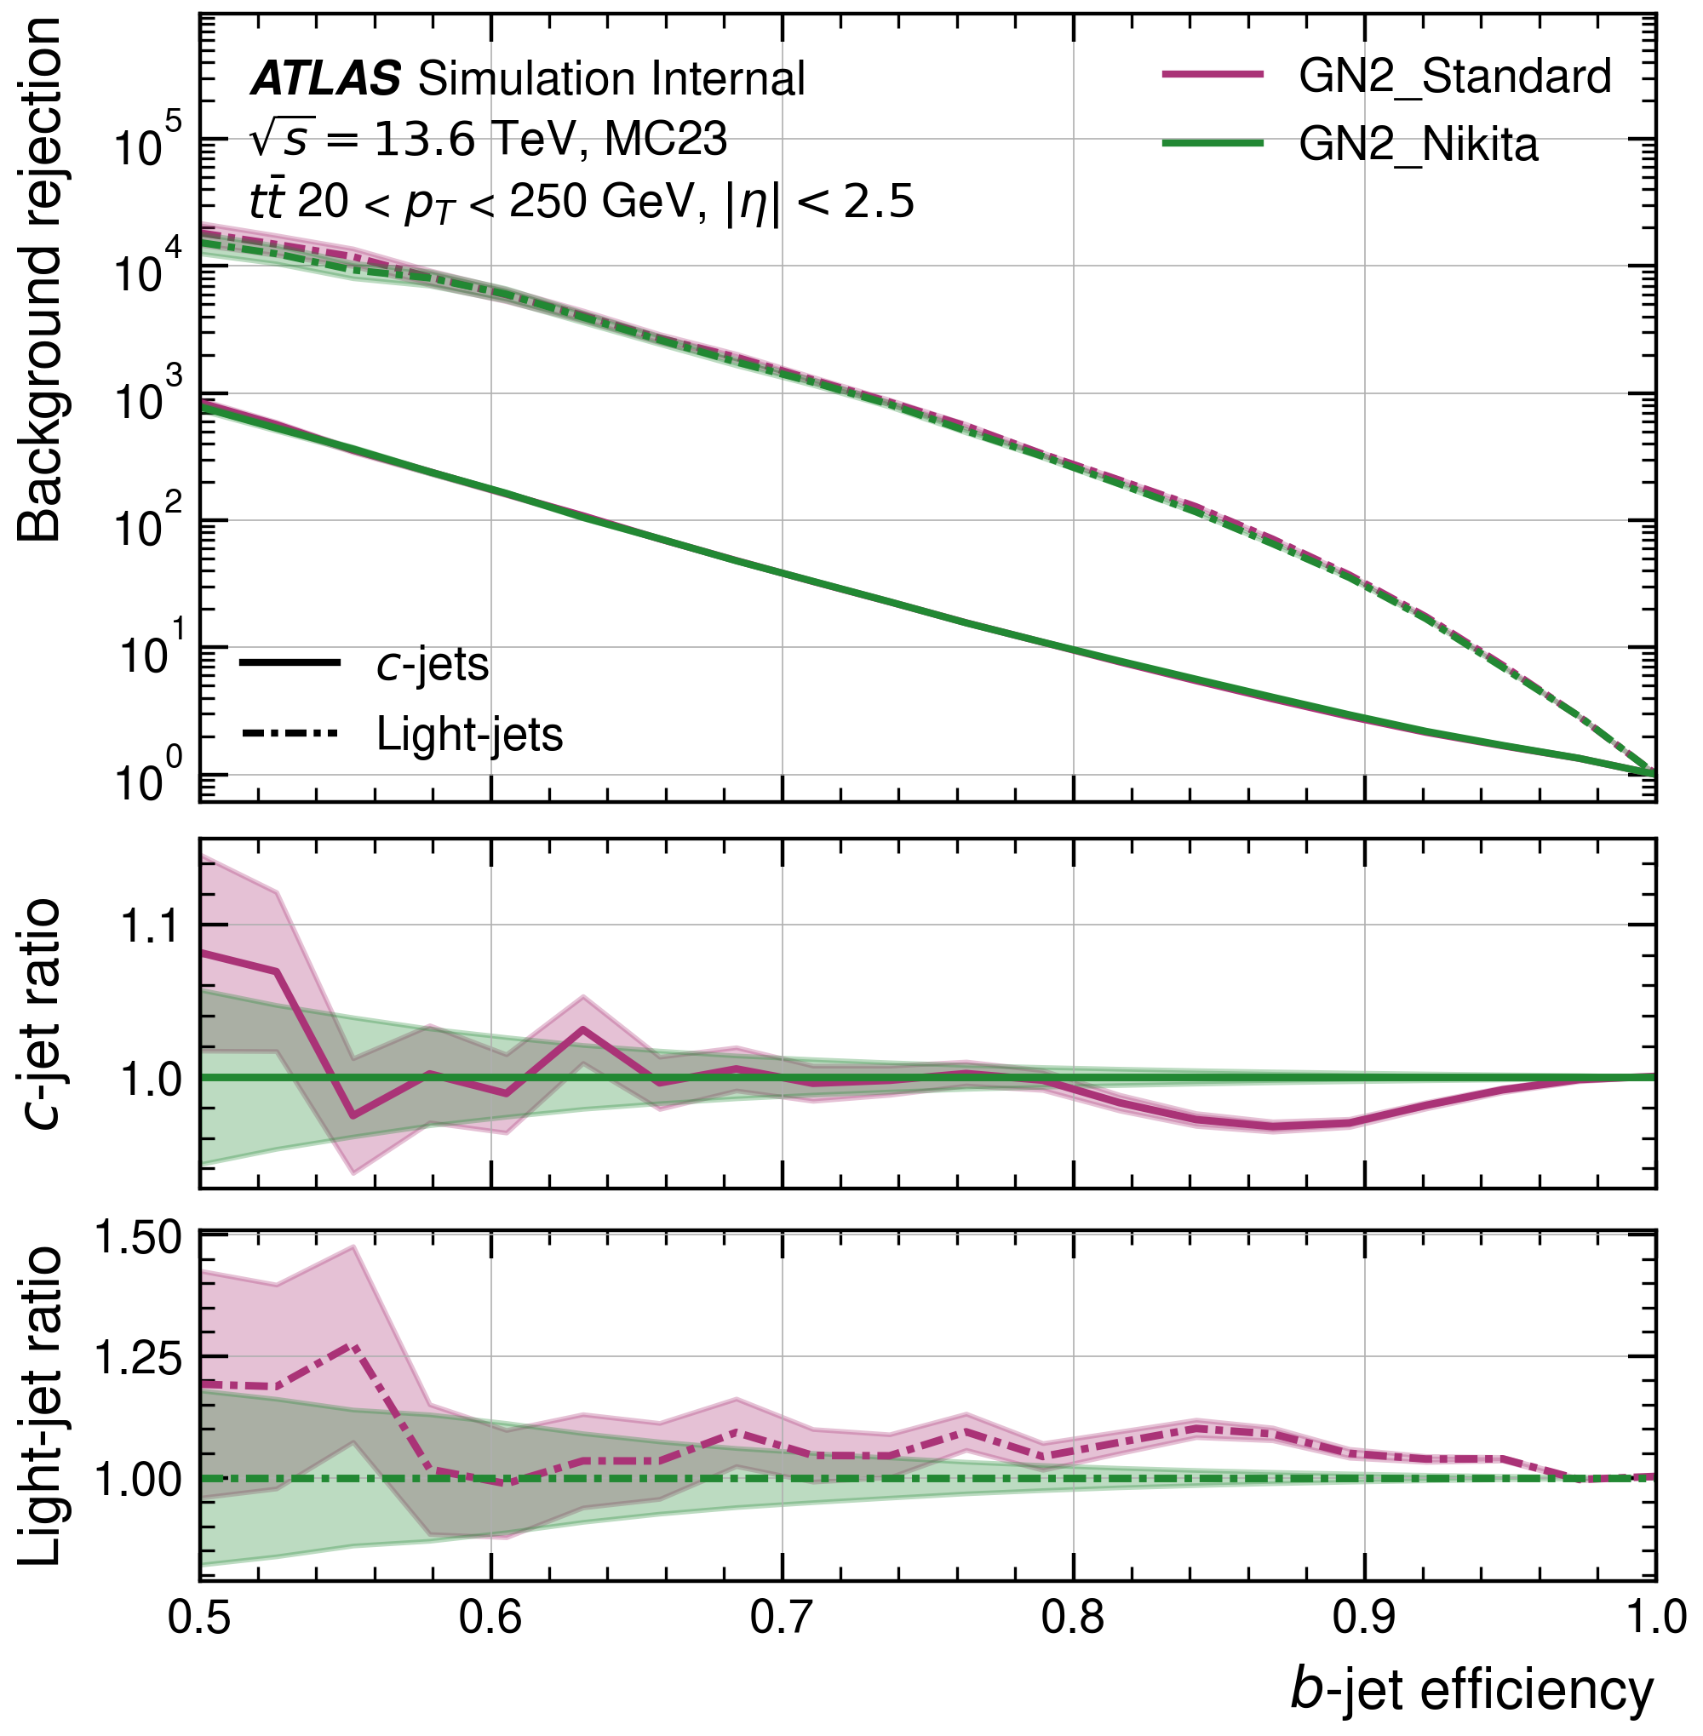
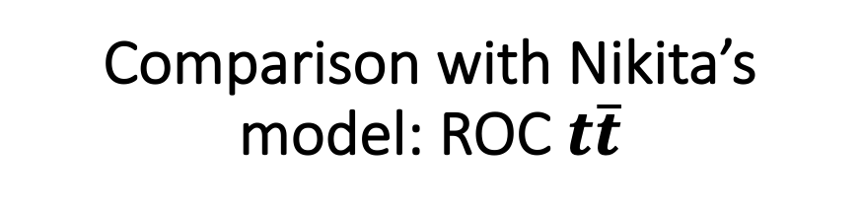
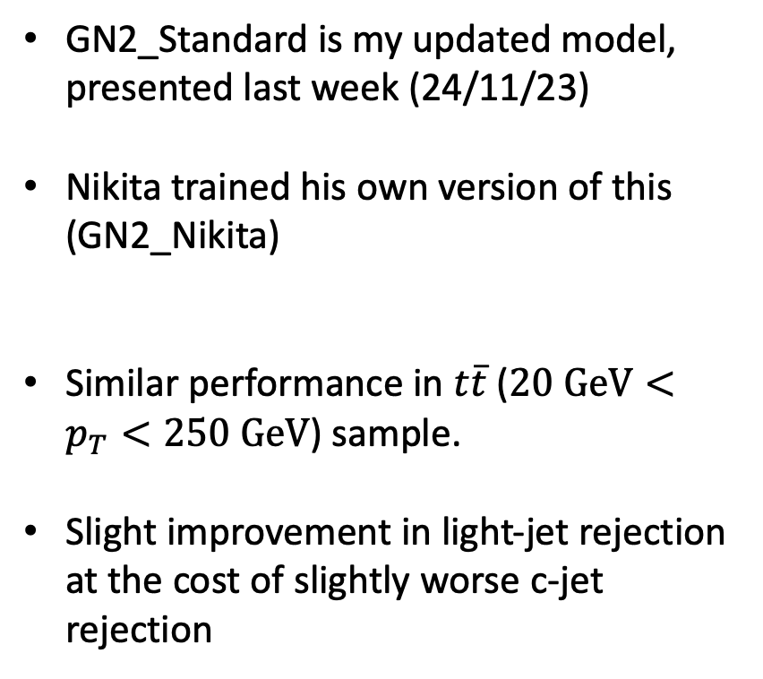
Comparison with Nikita’s model: ROC $t\overline{t}$
GN2_Standard is my updated model, presented last week (24/11/23)
Nikita trained his own version of this (GN2_Nikita)
Similar performance in $t\overline{t}$ ($20 GeV<p_{T}<250 GeV$) sample.
Slight improvement in light-jet rejection at the cost of slightly worse c-jet rejection

Slide 3
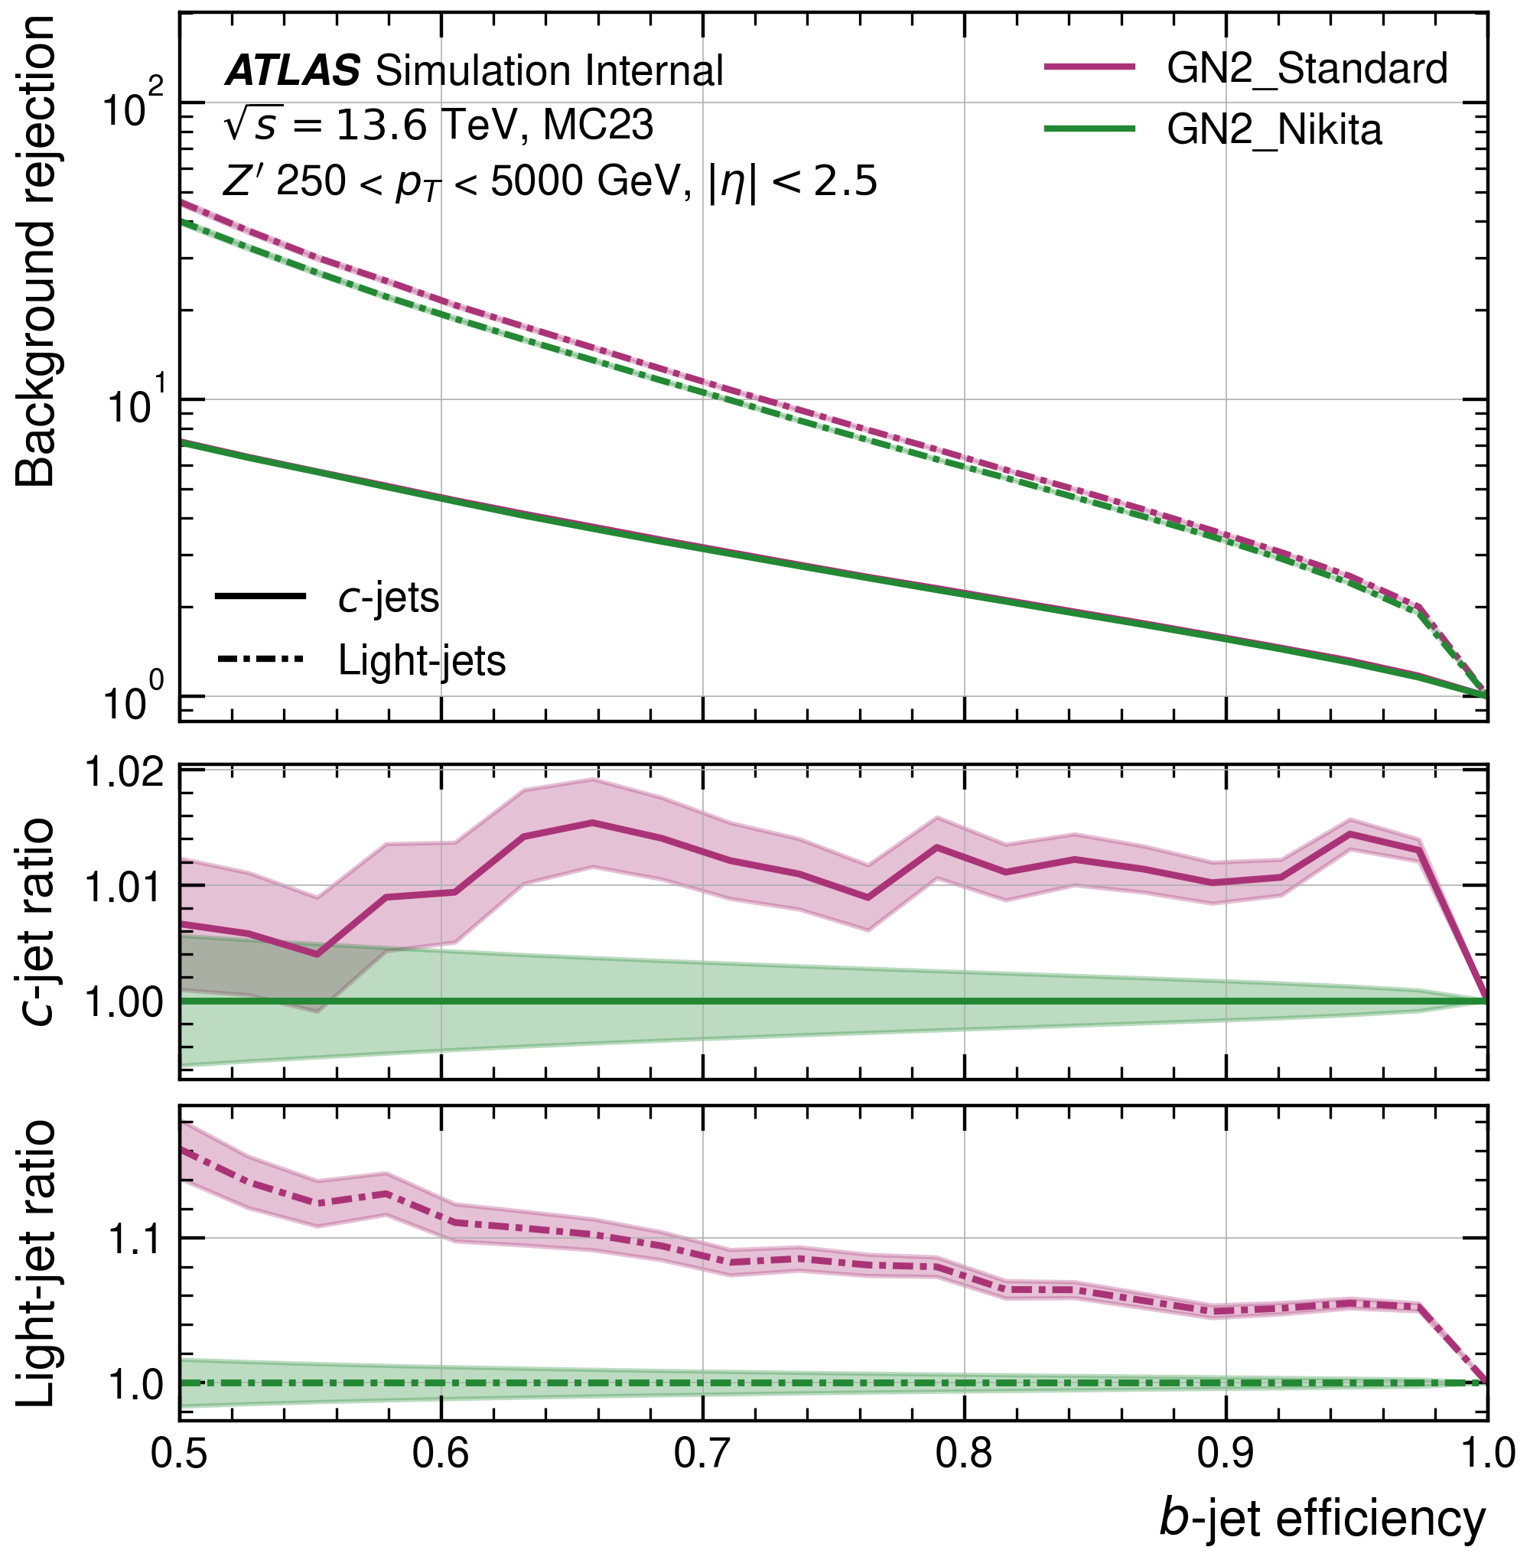
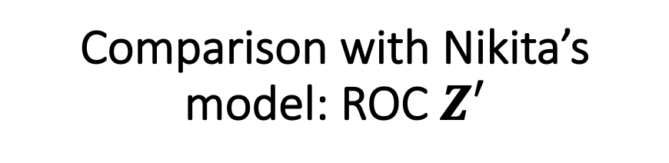
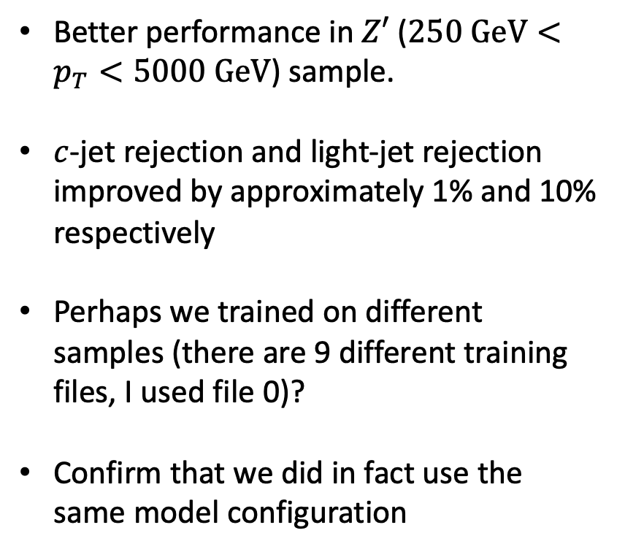
Comparison with Nikita’s model: ROC $Z′$
Better performance in $Z′$ ($250 GeV<p_{T}<5000 GeV$) sample.
$c$-jet rejection and light-jet rejection improved by approximately 1% and 10% respectively
Perhaps we trained on different samples (there are 9 different training files, I used file 0)?
Confirm that we did in fact use the same model configuration

Slide 4
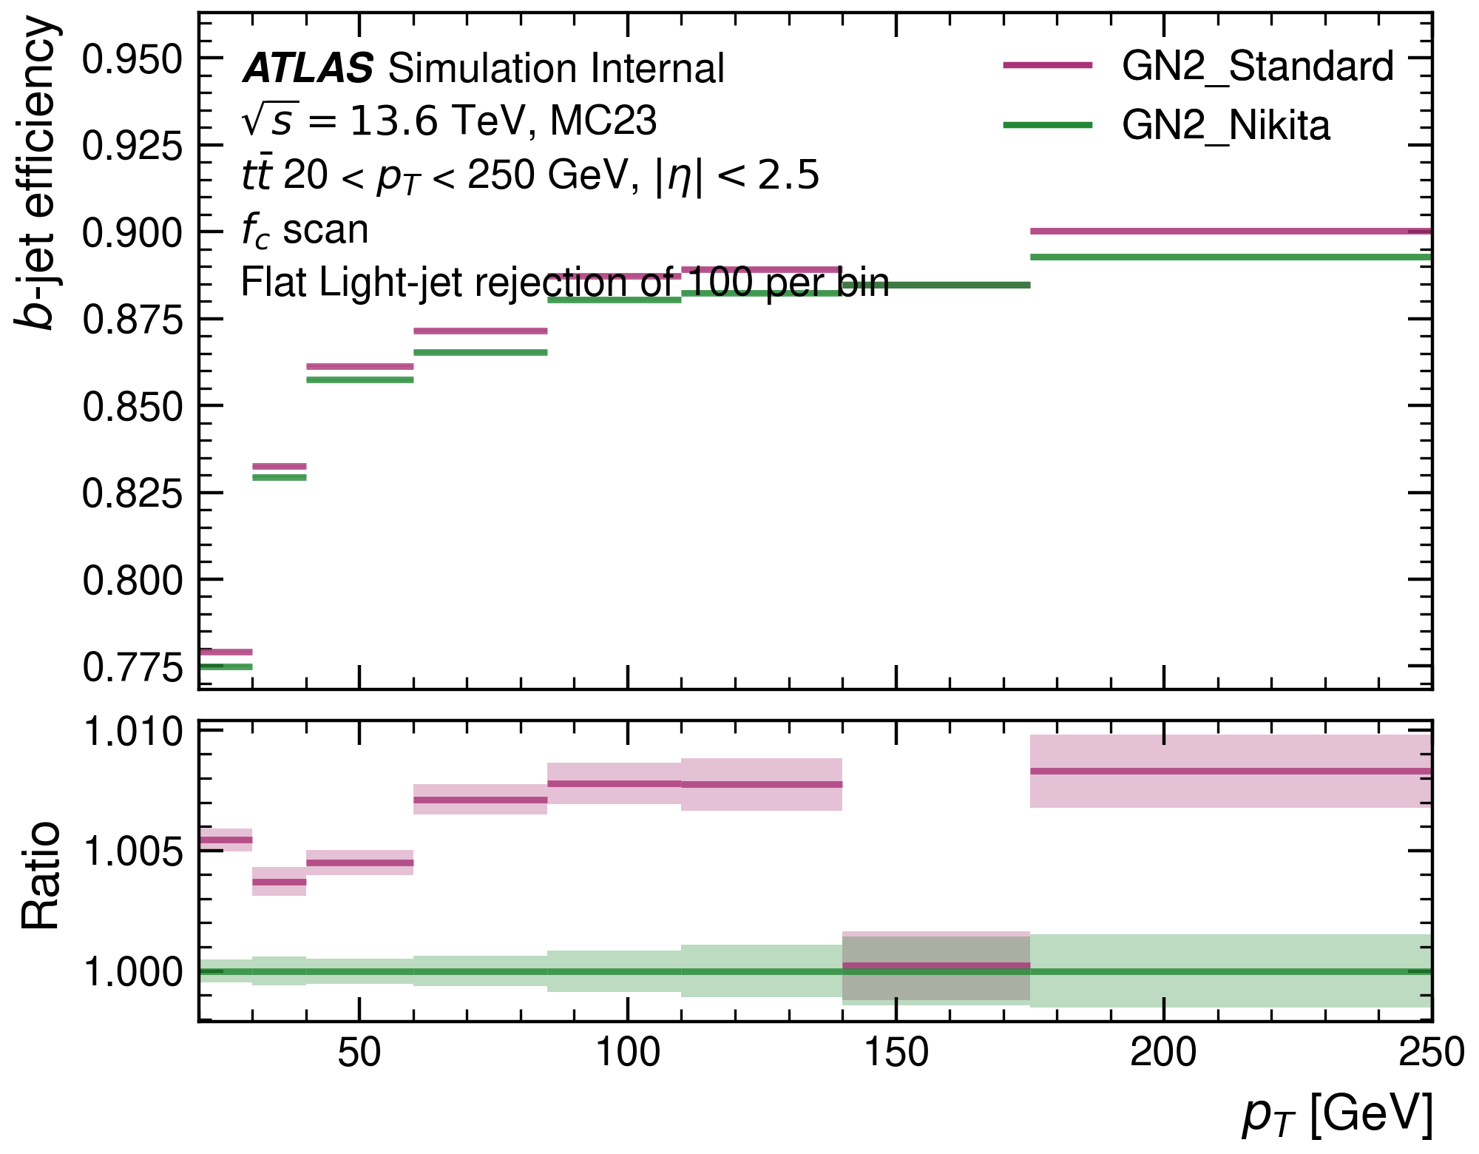
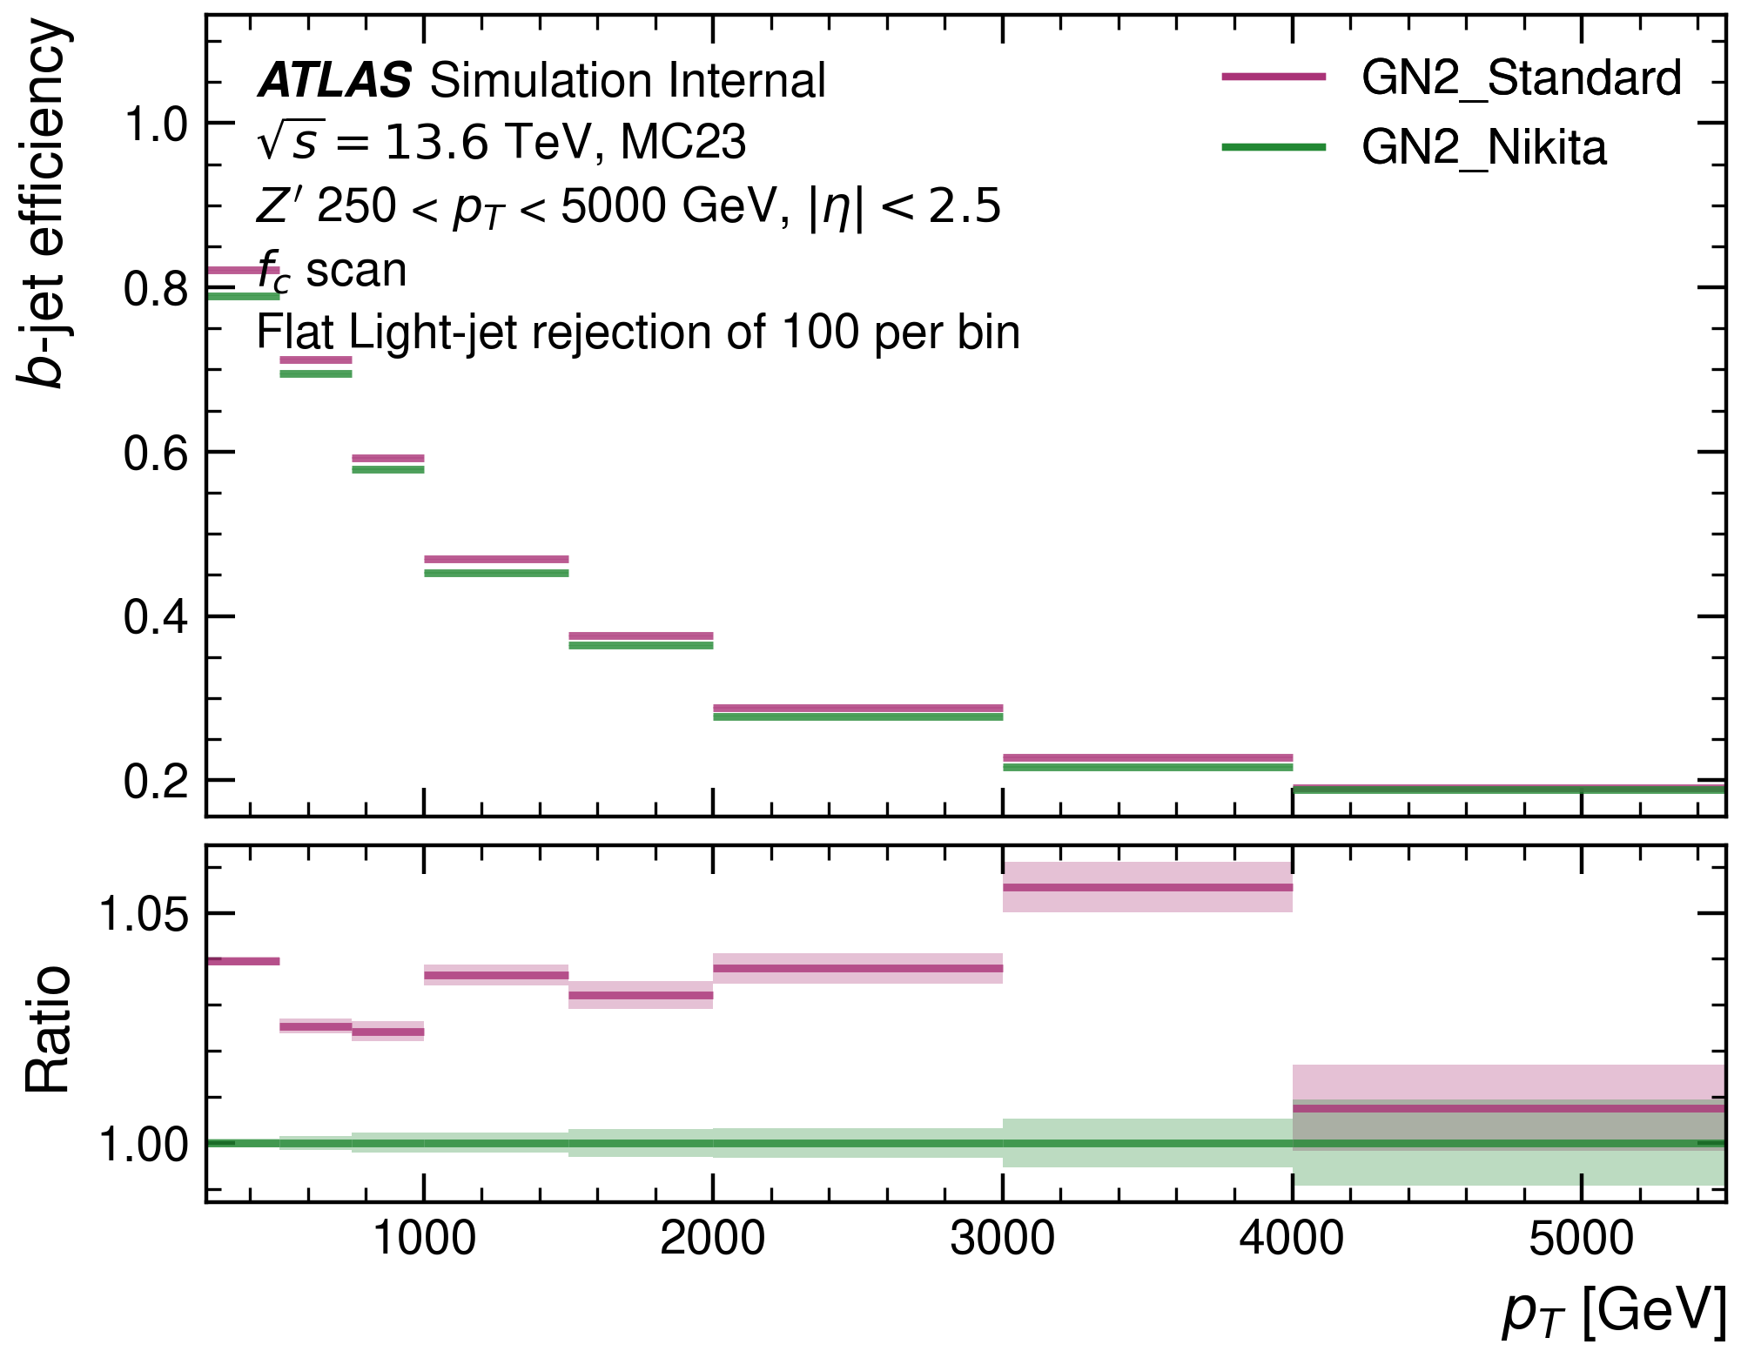
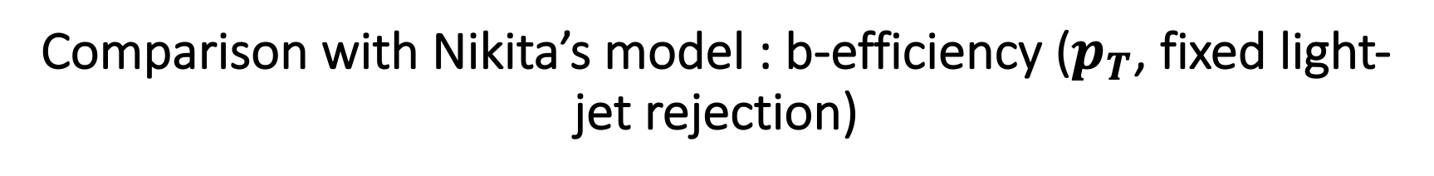
Comparison with Nikita’s model : b-efficiency ($p_{T}$, fixed light-jet rejection)
$b$-efficiency over $p_{T}$ with fixed light-jet rejection shows similar results.

Slide 5
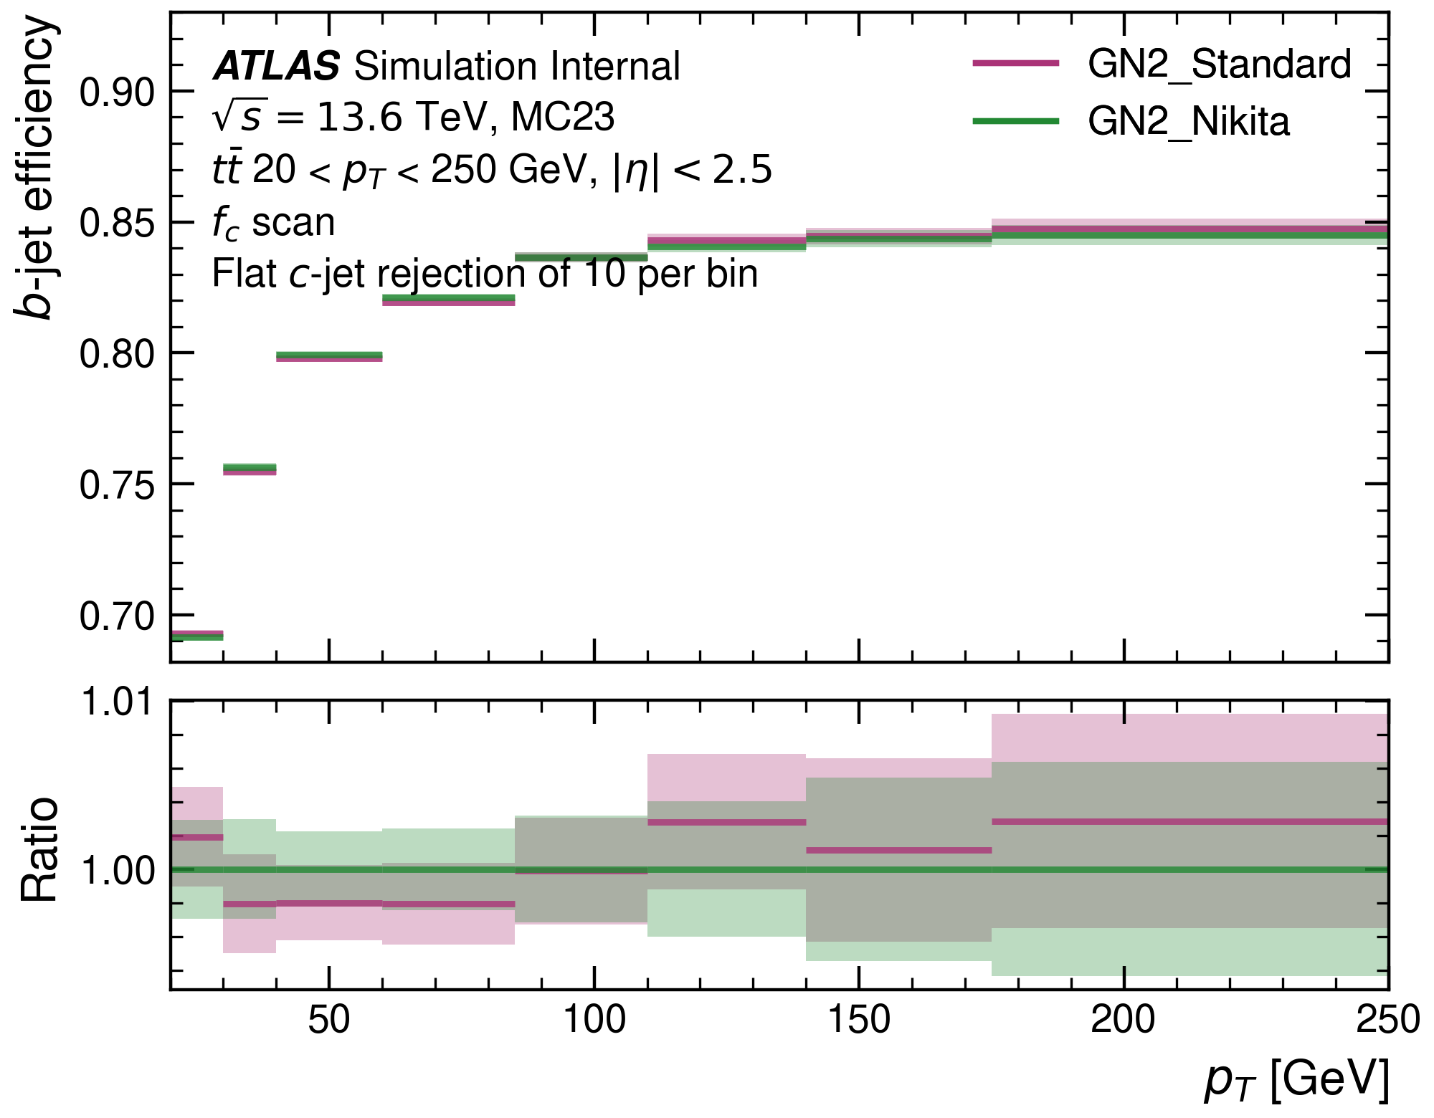
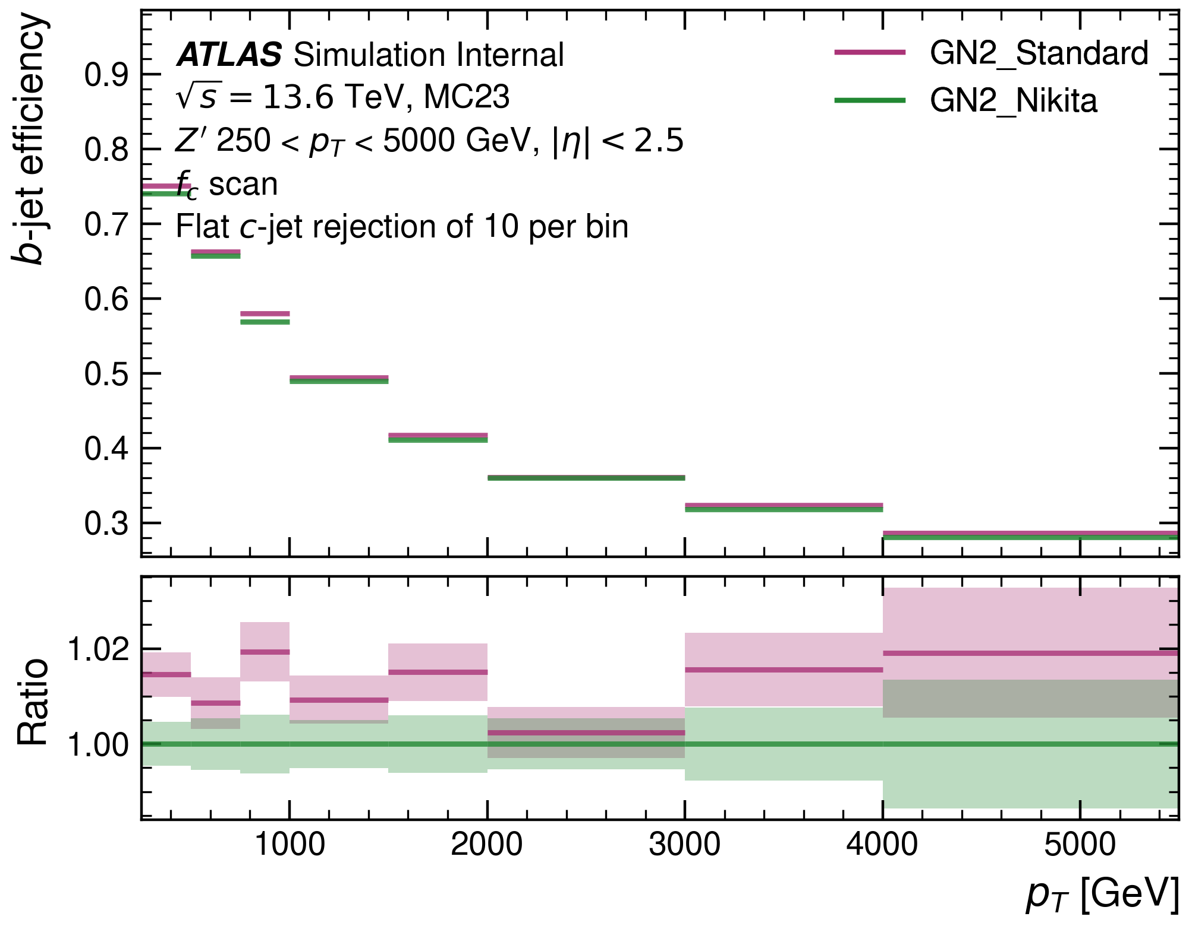
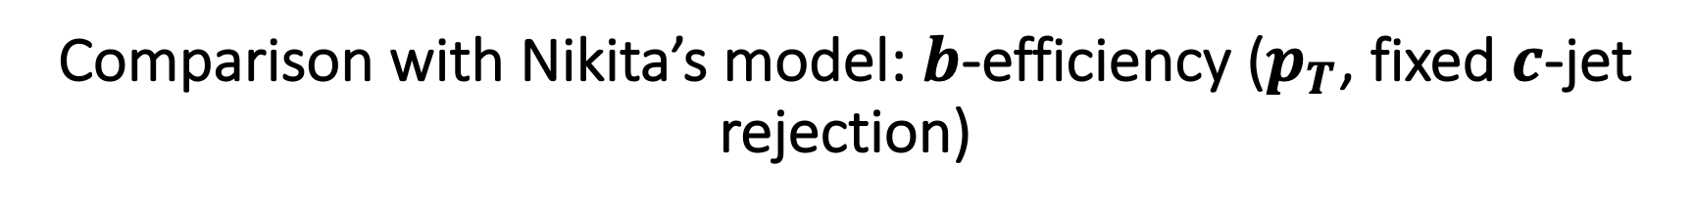
Comparison with Nikita’s model: $b$-efficiency ($p_{T}$, fixed $c$-jet rejection)
$b$-efficiency over $p_{T}$ with fixed $c$-jet rejection also shows similar results.

Slide 6
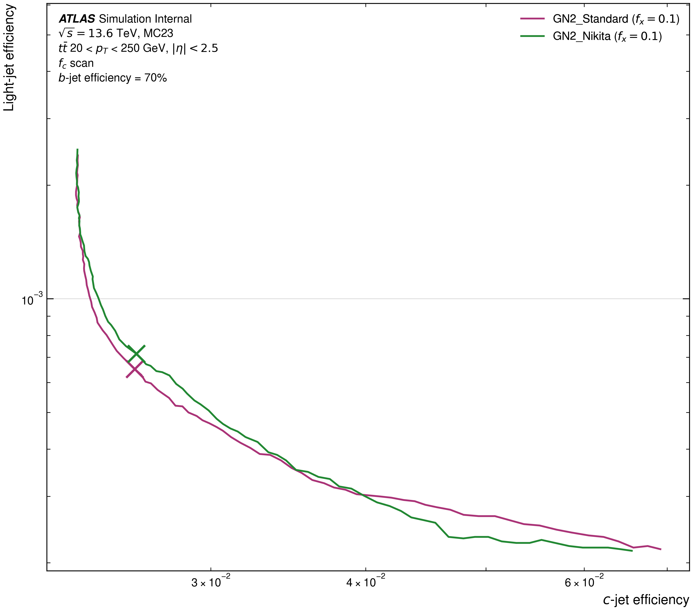
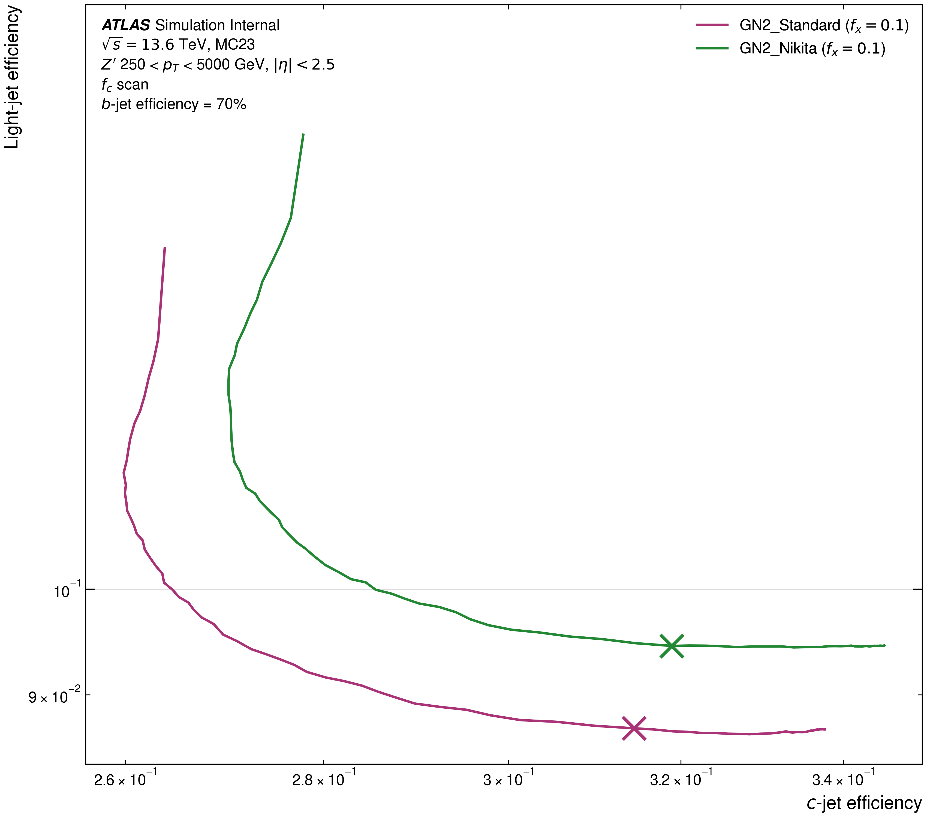
Comparison with Nikita’s model: $f_{c}$-curves
In $t\overline{t}$-sample both favour light-jet efficiency, in $Z′$-sample both favour c-jet efficiency.

Slide 7
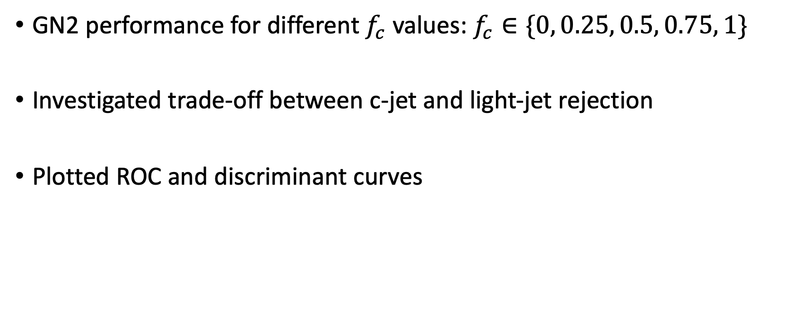

Performance of GN2 with different $f_{c}$
GN2 performance for different $f_{c}$ values: $f_{c}∈\{0, 0.25, 0.5, 0.75, 1\}$
Investigated trade-off between c-jet and light-jet rejection
Plotted ROC and discriminant curves

Slide 8
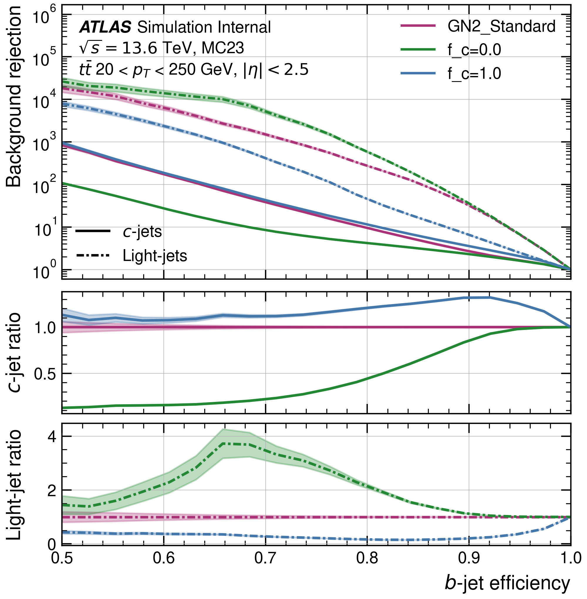
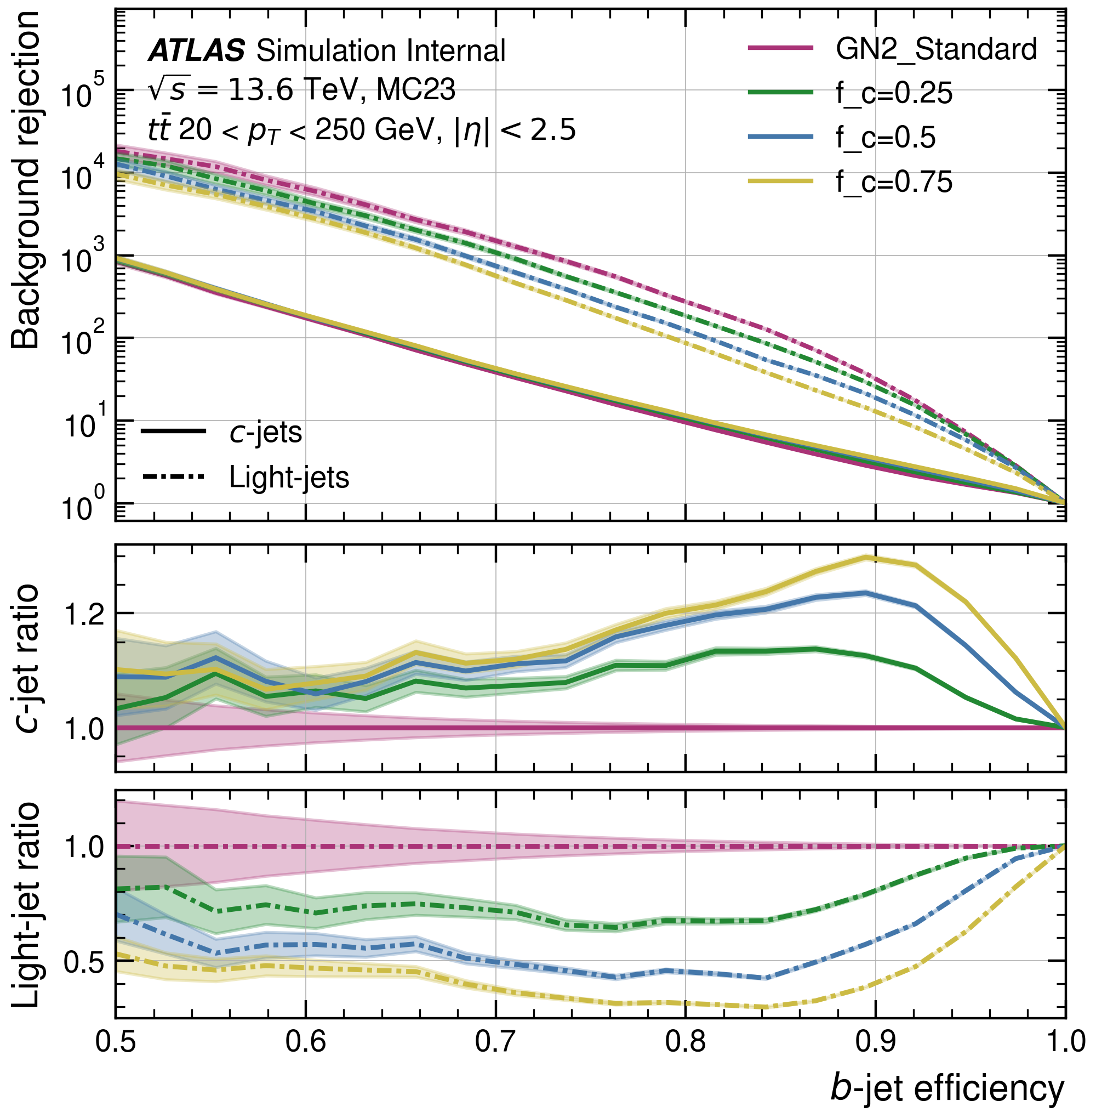
Performance of GN2 with different $f_{c}$: ROC $t\overline{t}$-sample
Clearly demonstrates that for the $t\overline{t}$-sample, the higher the $f_{c}$, the better the $c$-rejection, and the worse the light-rejection.

Slide 9
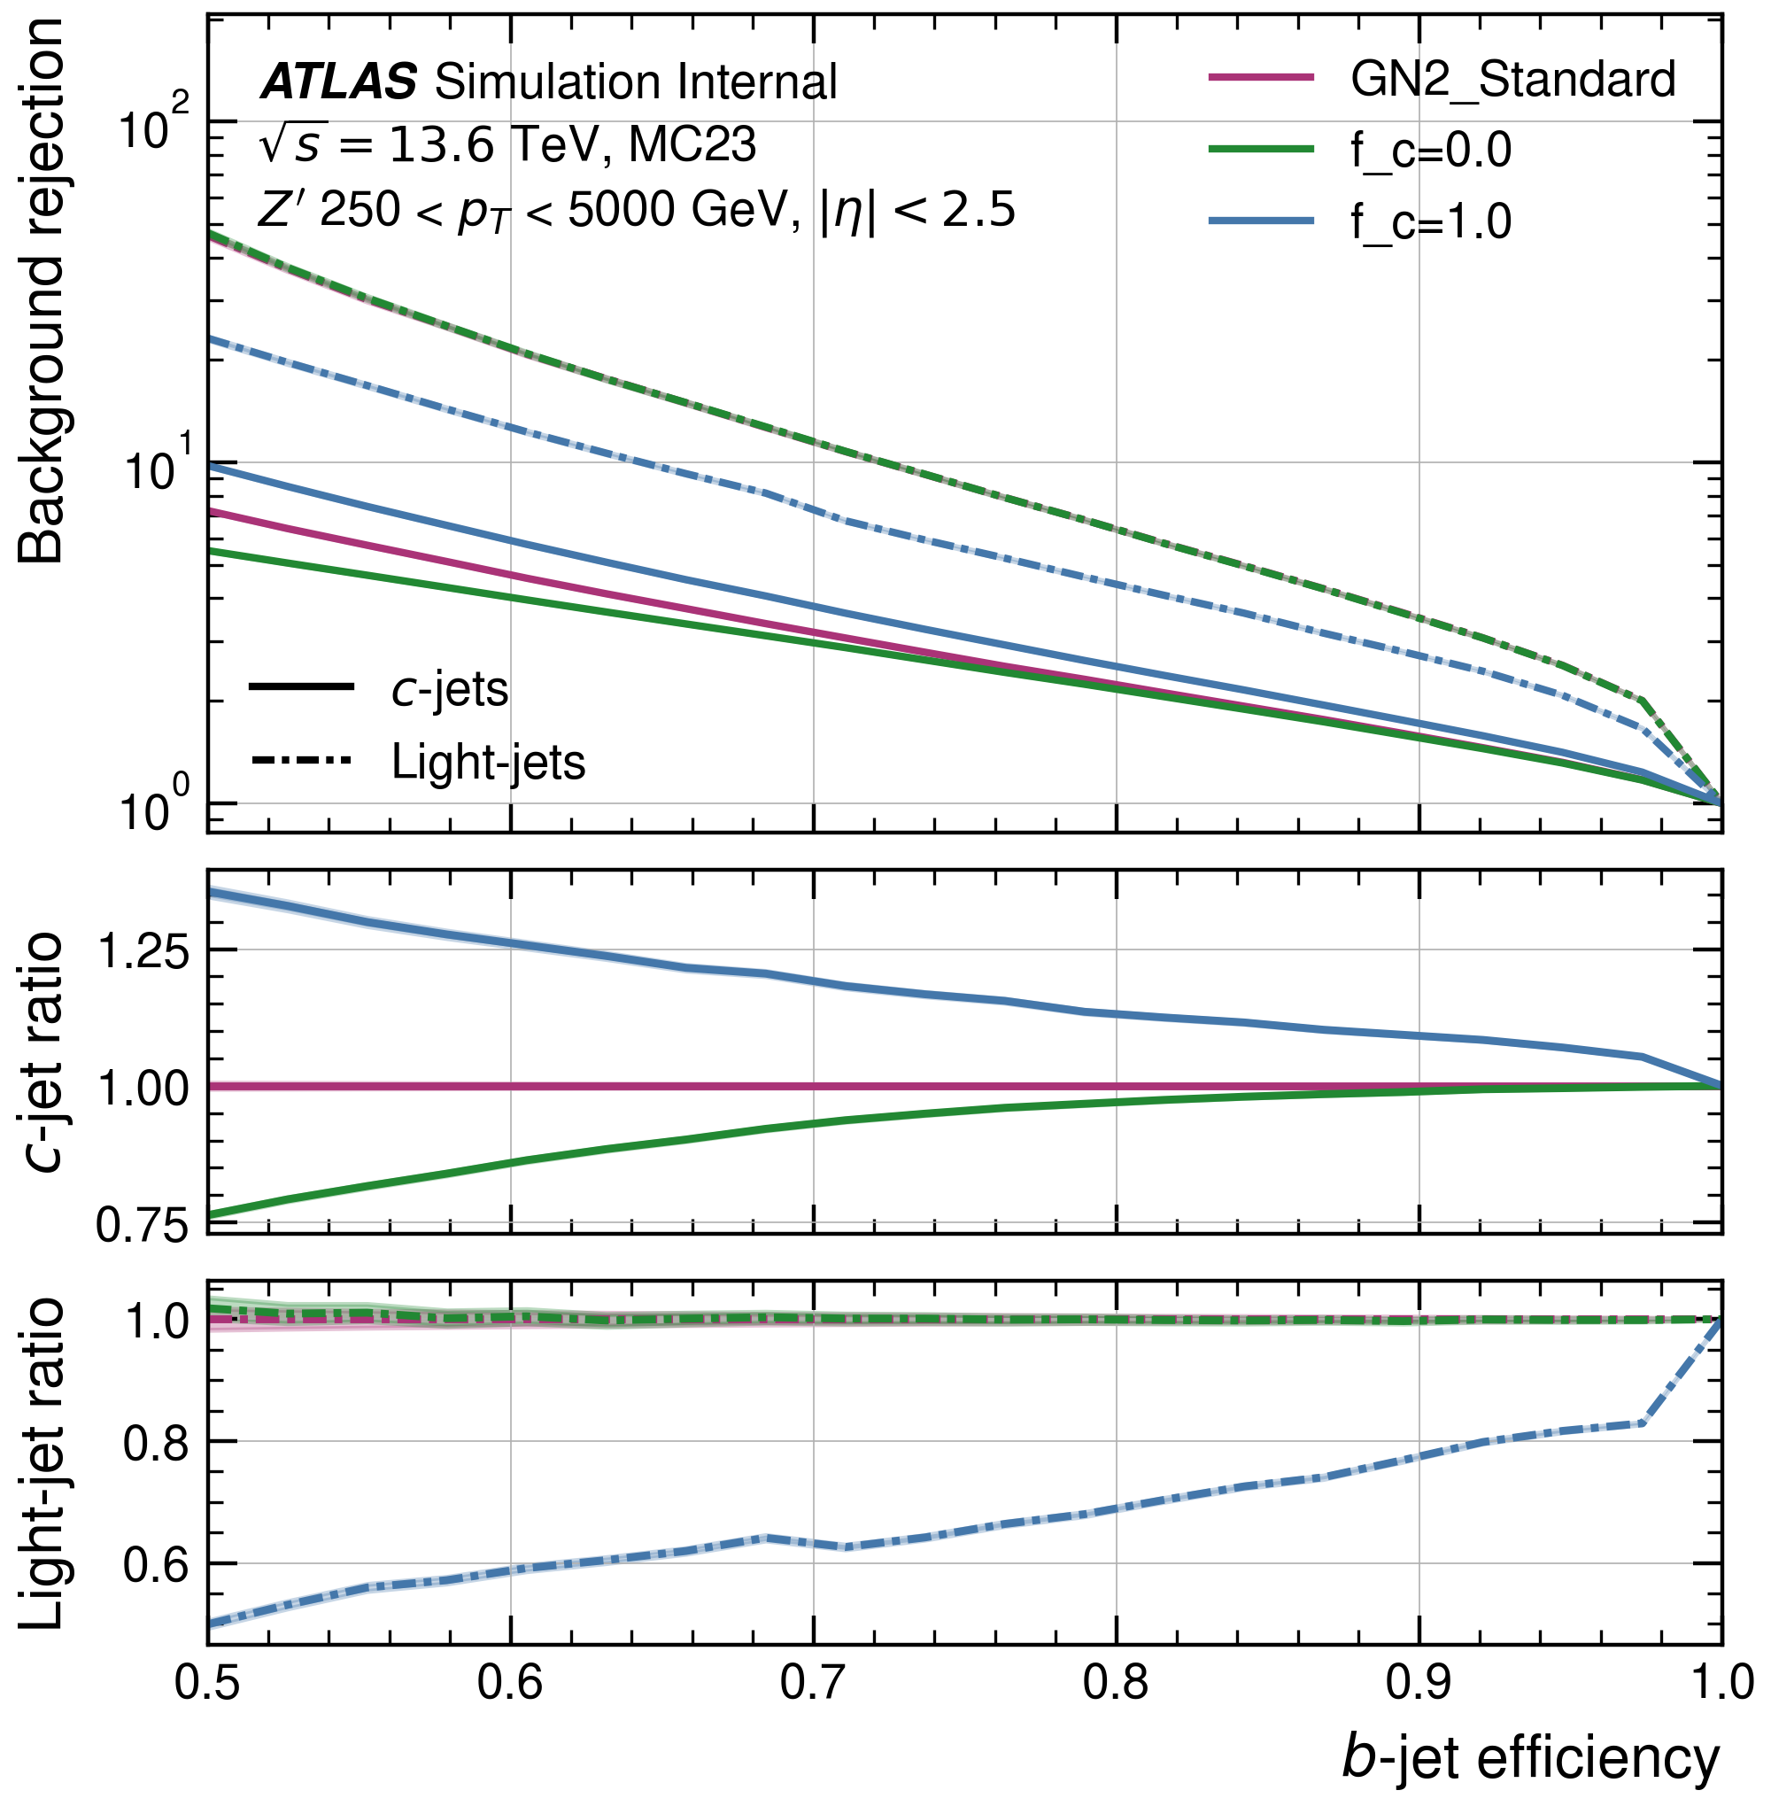
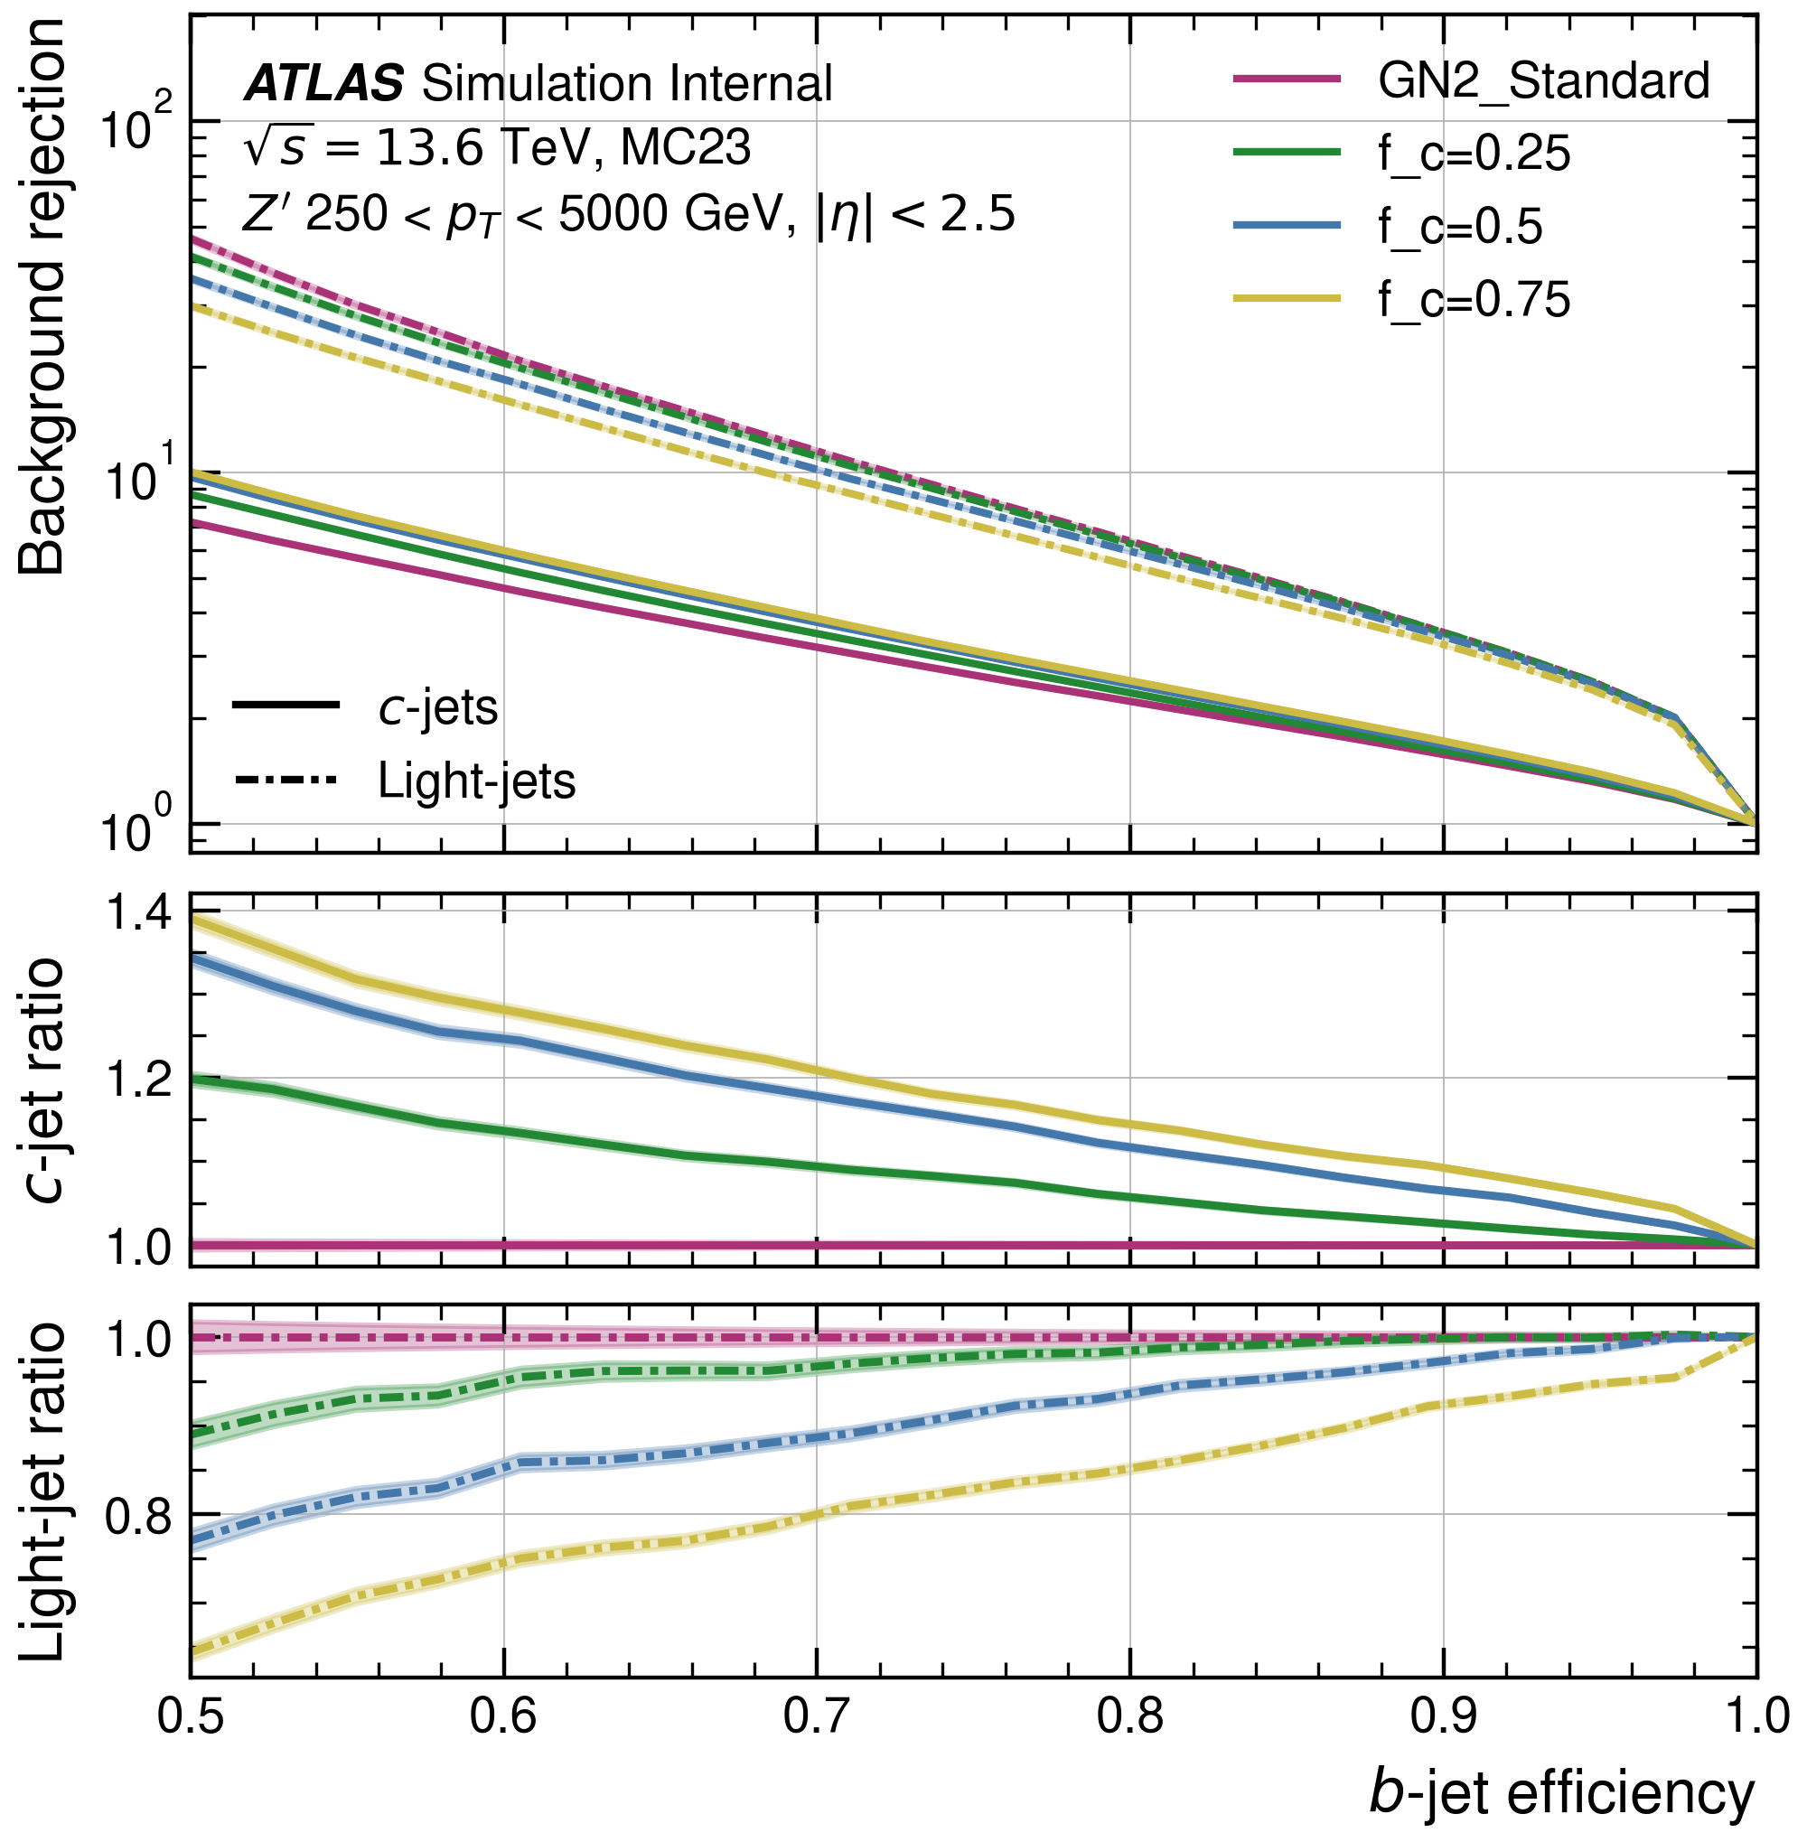
Performance of GN2 with different $f_{c}$: ROC $Z′$-sample
The same result holds for $Z′$: The higher the $f_{c}$, the better the $c$-rejection, and the worse the light-rejection.

Slide 10
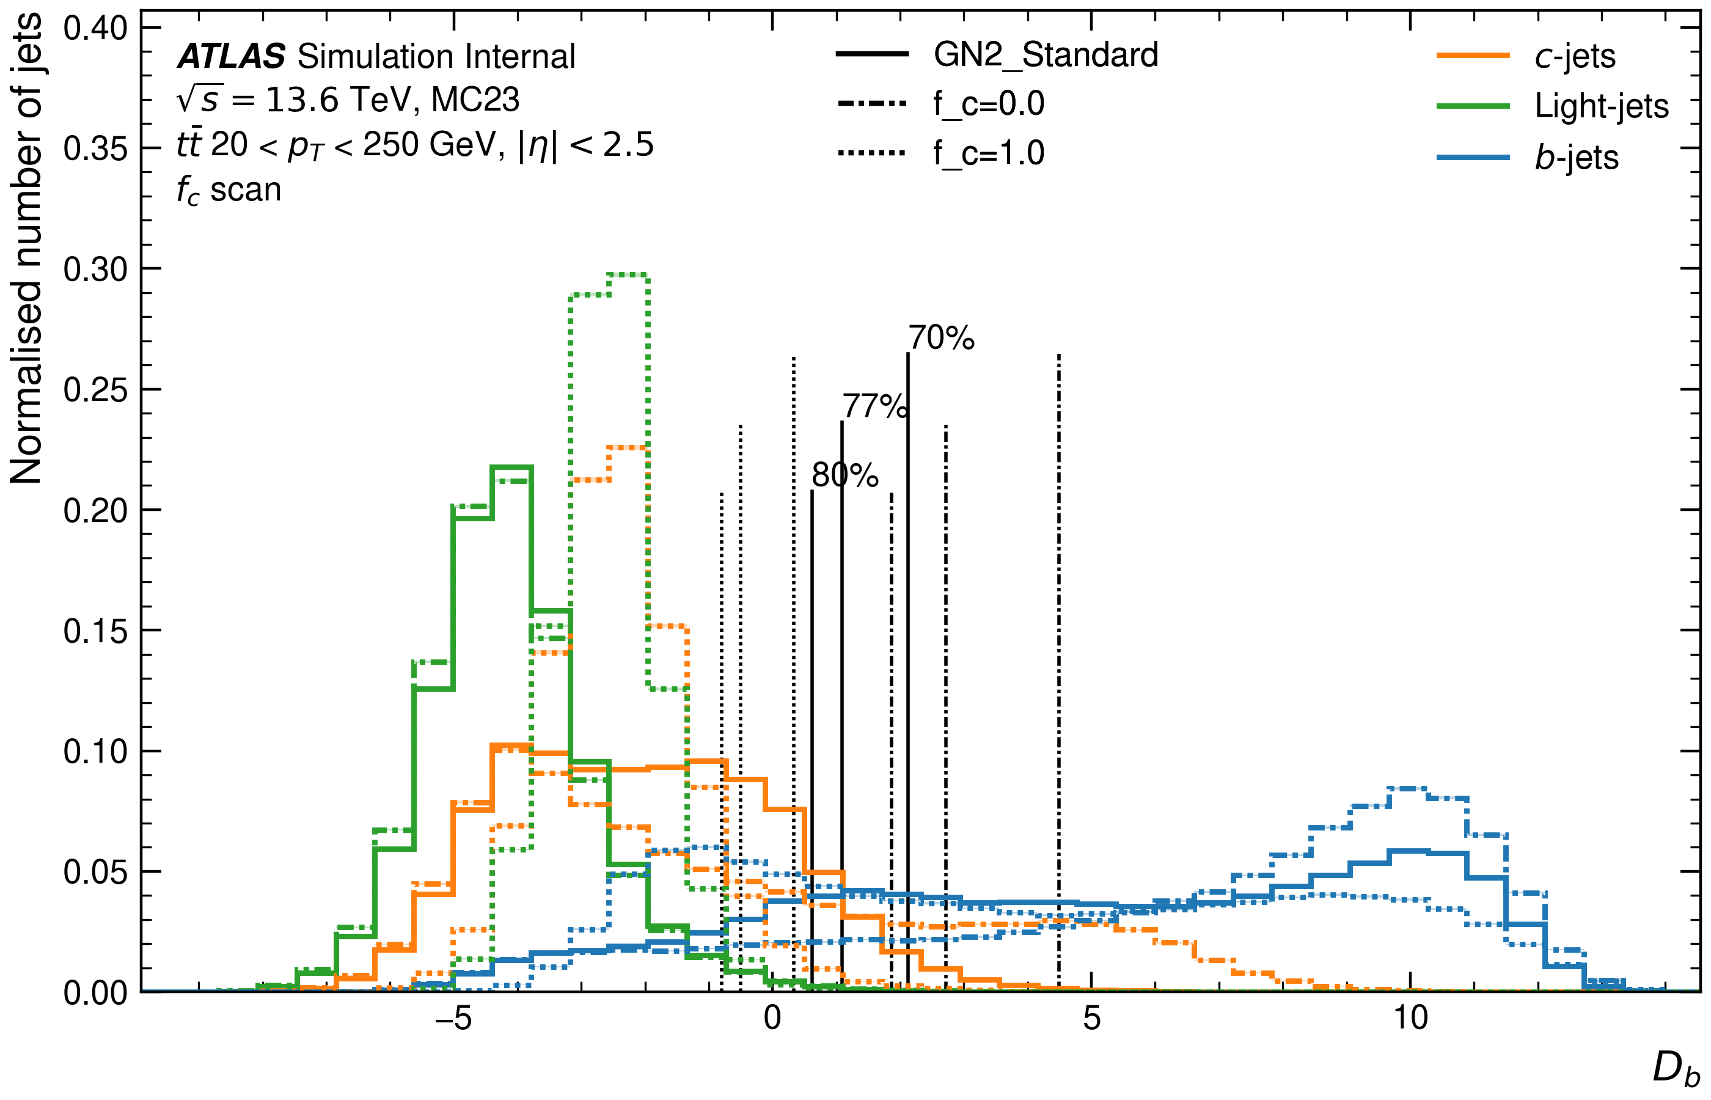
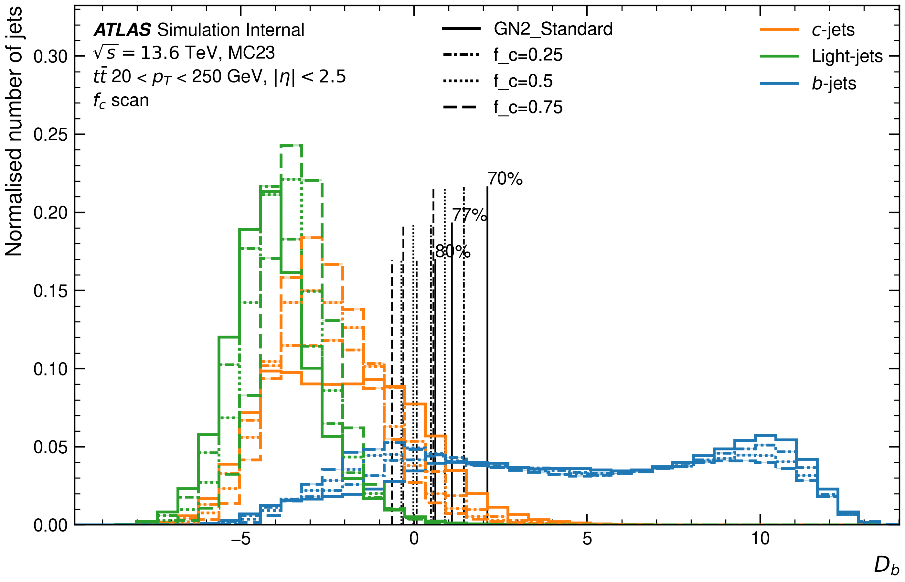
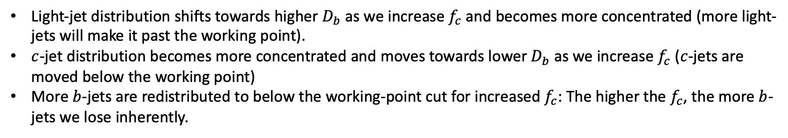
Performance of GN2 with different $f_{c}$: Discriminant ($t\overline{t}$)
Light-jet distribution shifts towards higher $D_{b}$ as we increase $f_{c}$ and becomes more concentrated (more light-jets will make it past the working point).
$c$-jet distribution becomes more concentrated and moves towards lower $D_{b}$ as we increase $f_{c}$ ($c$-jets are moved below the working point)
More $b$-jets are redistributed to below the working-point cut for increased $f_{c}$: The higher the $f_{c}$, the more $b$-jets we lose inherently.

Slide 11
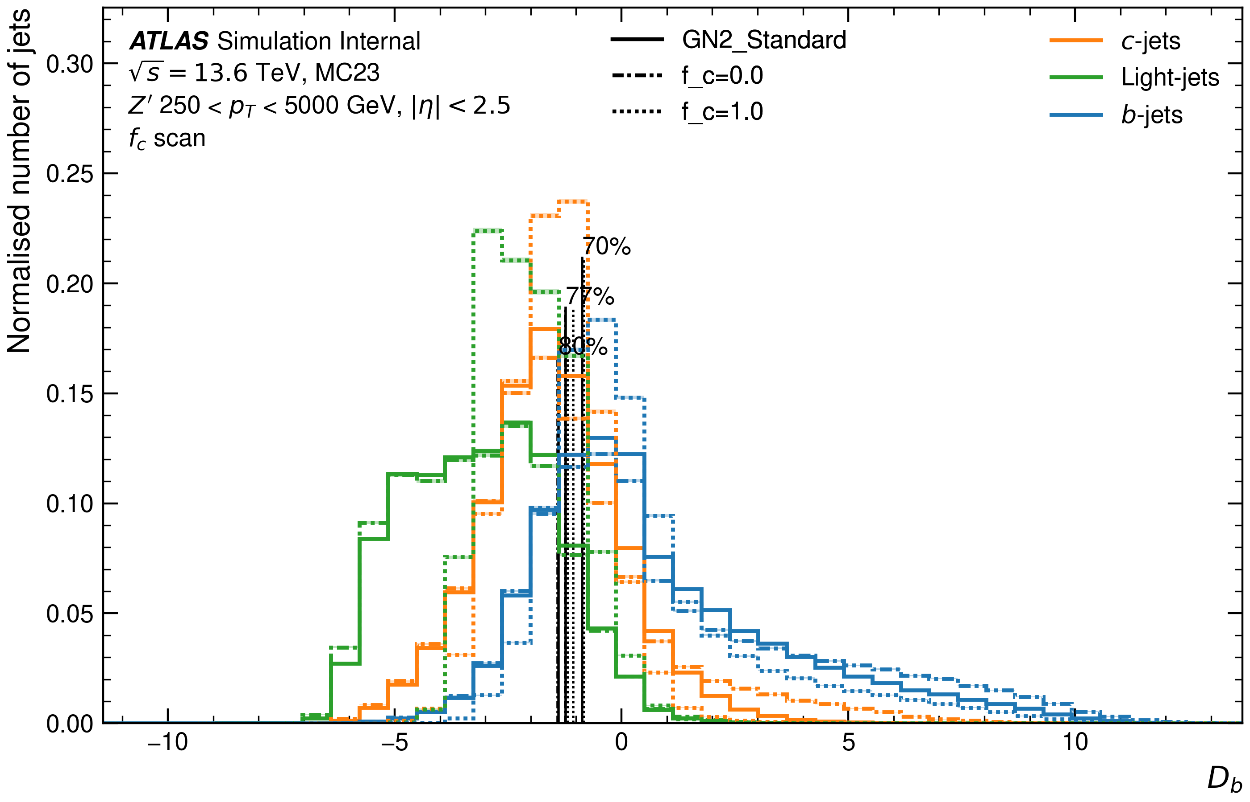
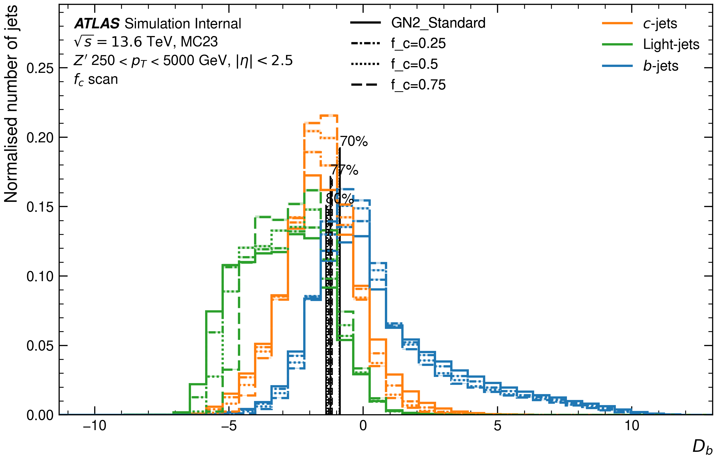
Performance of GN2 with different $f_{c}$: Discriminant ($Z′$)
The same results holds for the $Z′$-sample, the distributions overlap substantially more in this case.

Slide 12
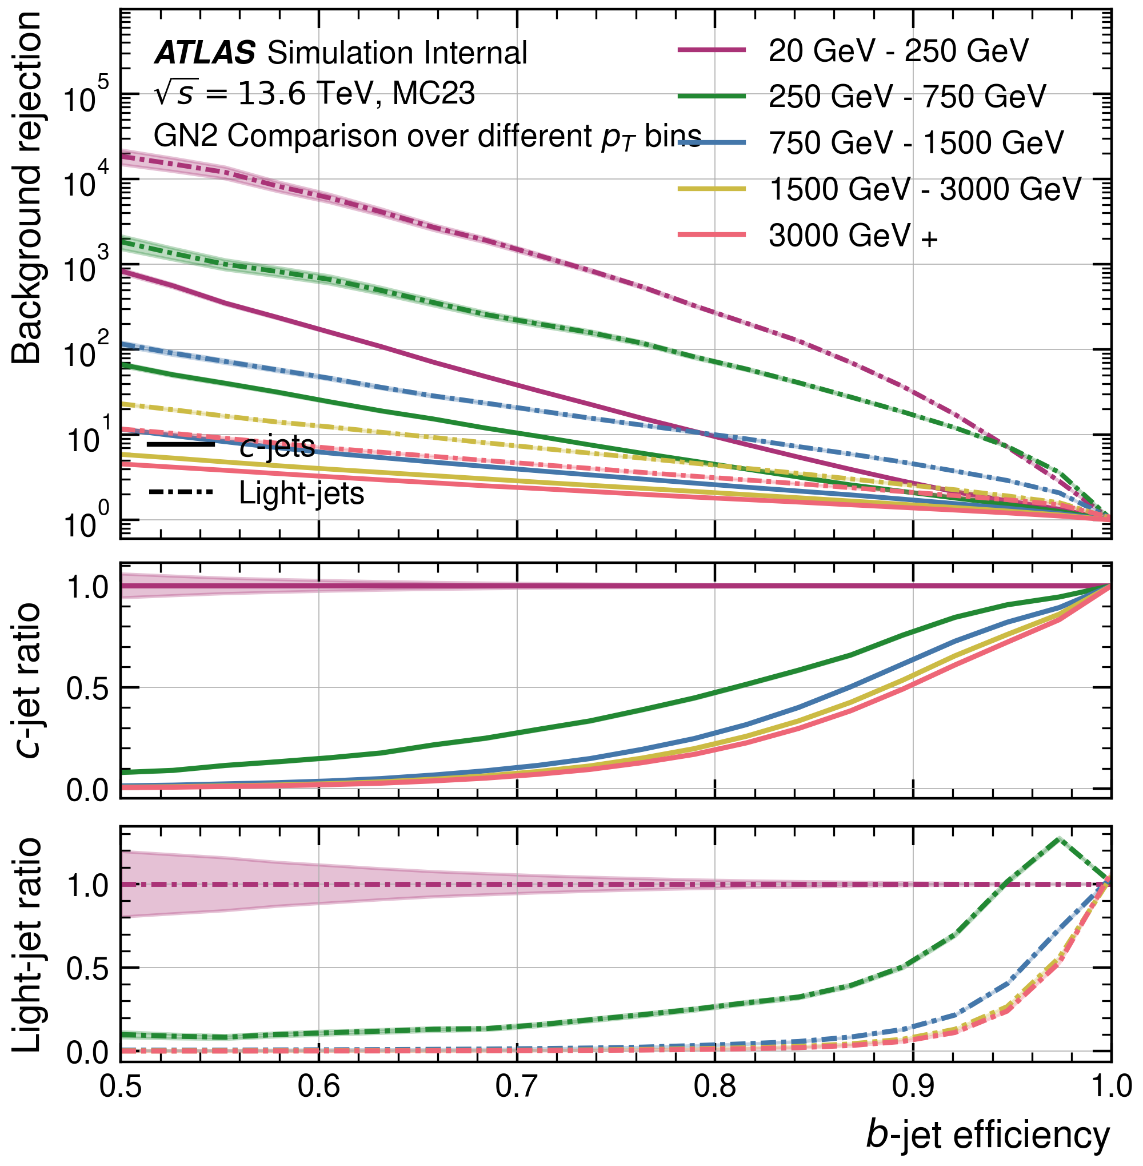
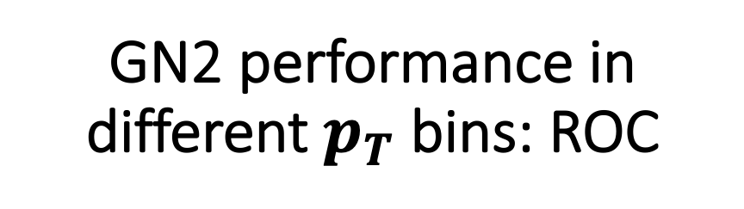
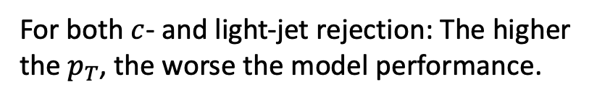
GN2 performance in different $p_{T}$ bins: ROC
For both $c$- and light-jet rejection: The higher the $p_{T}$, the worse the model performance.

Slide 13
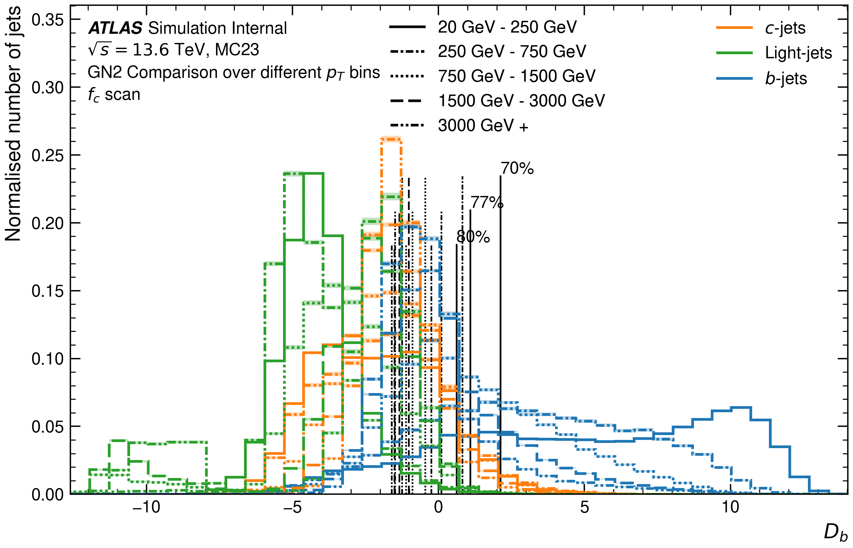
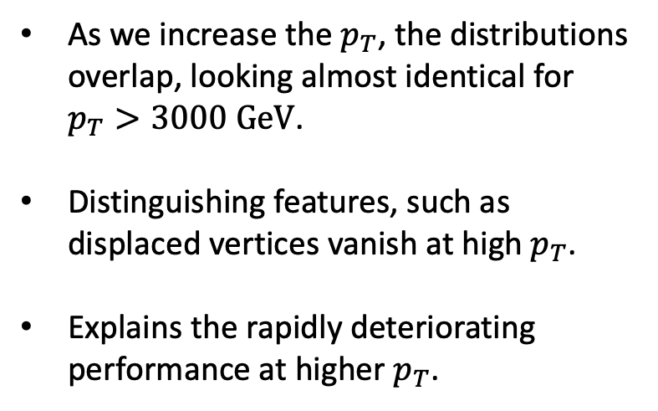
GN2 performance in different $p_{T}$ bins: Discriminant
As we increase the $p_{T}$, the distributions overlap, looking almost identical for $p_{T}>3000 GeV$.
Distinguishing features, such as displaced vertices vanish at high $p_{T}$.
Explains the rapidly deteriorating performance at higher $p_{T}$.

Slide 14
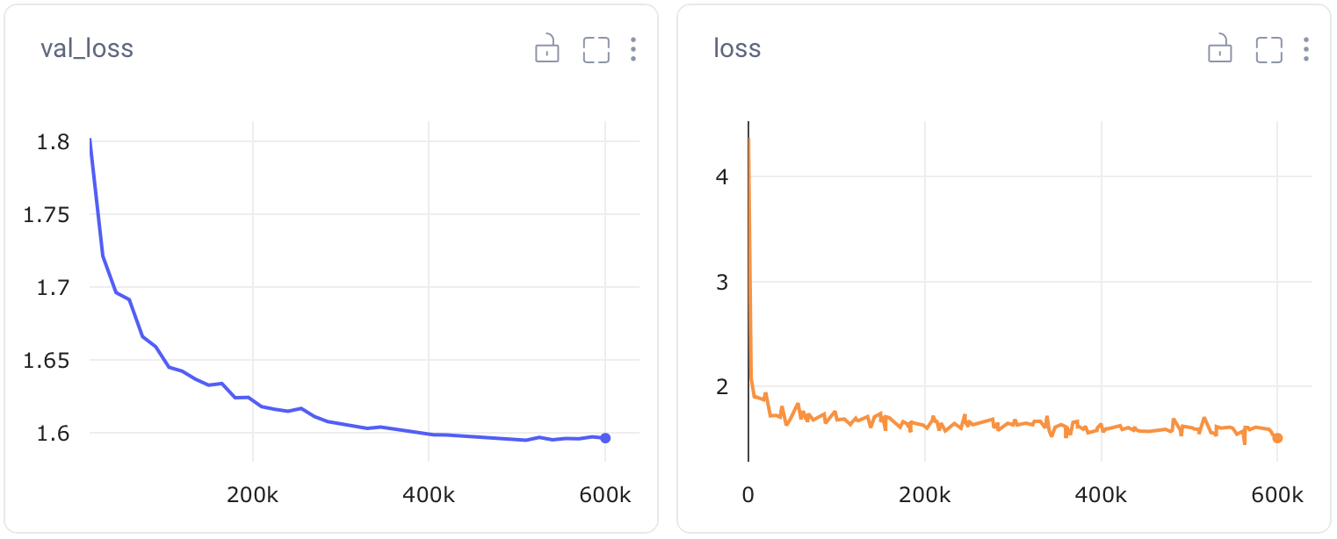
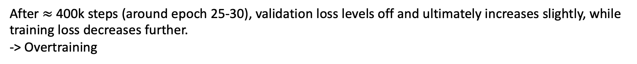
Network Overfitting
After $≈$ 400k steps (around epoch 25-30), validation loss levels off and ultimately increases slightly, while training loss decreases further.
-> Overtraining

Slide 15
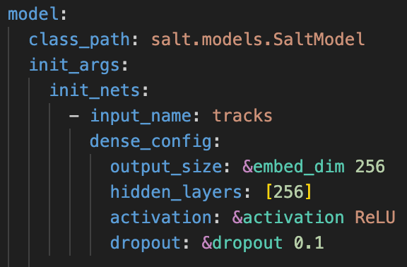
Network Overfitting: Re-training
Prevent overfitting by adding more dropout layers.
Added 0.1 dropout to every layer.
Re-trained with all other parameters unchanged.

Slide 16
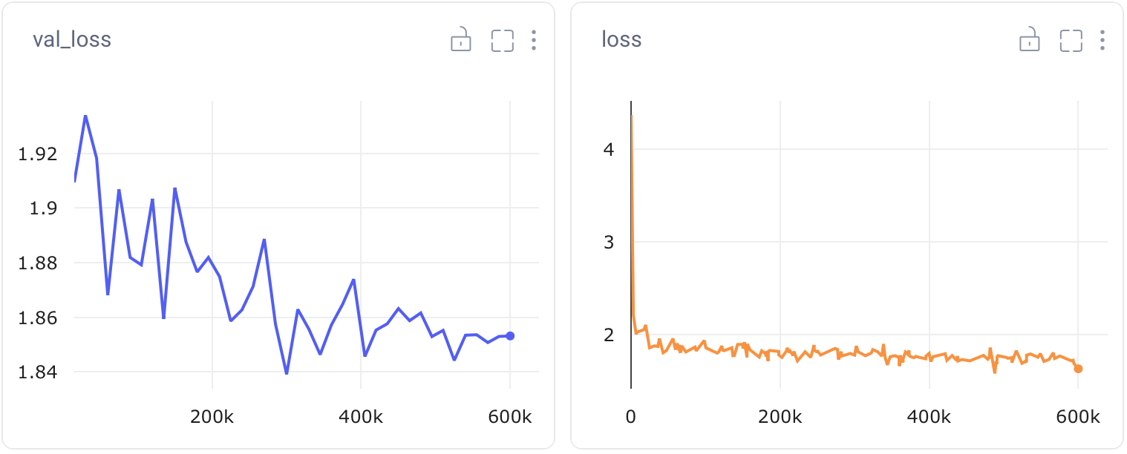
Network Overfitting: Re-training results
Training extremely slow
poor validation and training performance compared to previous model.

Slide 17
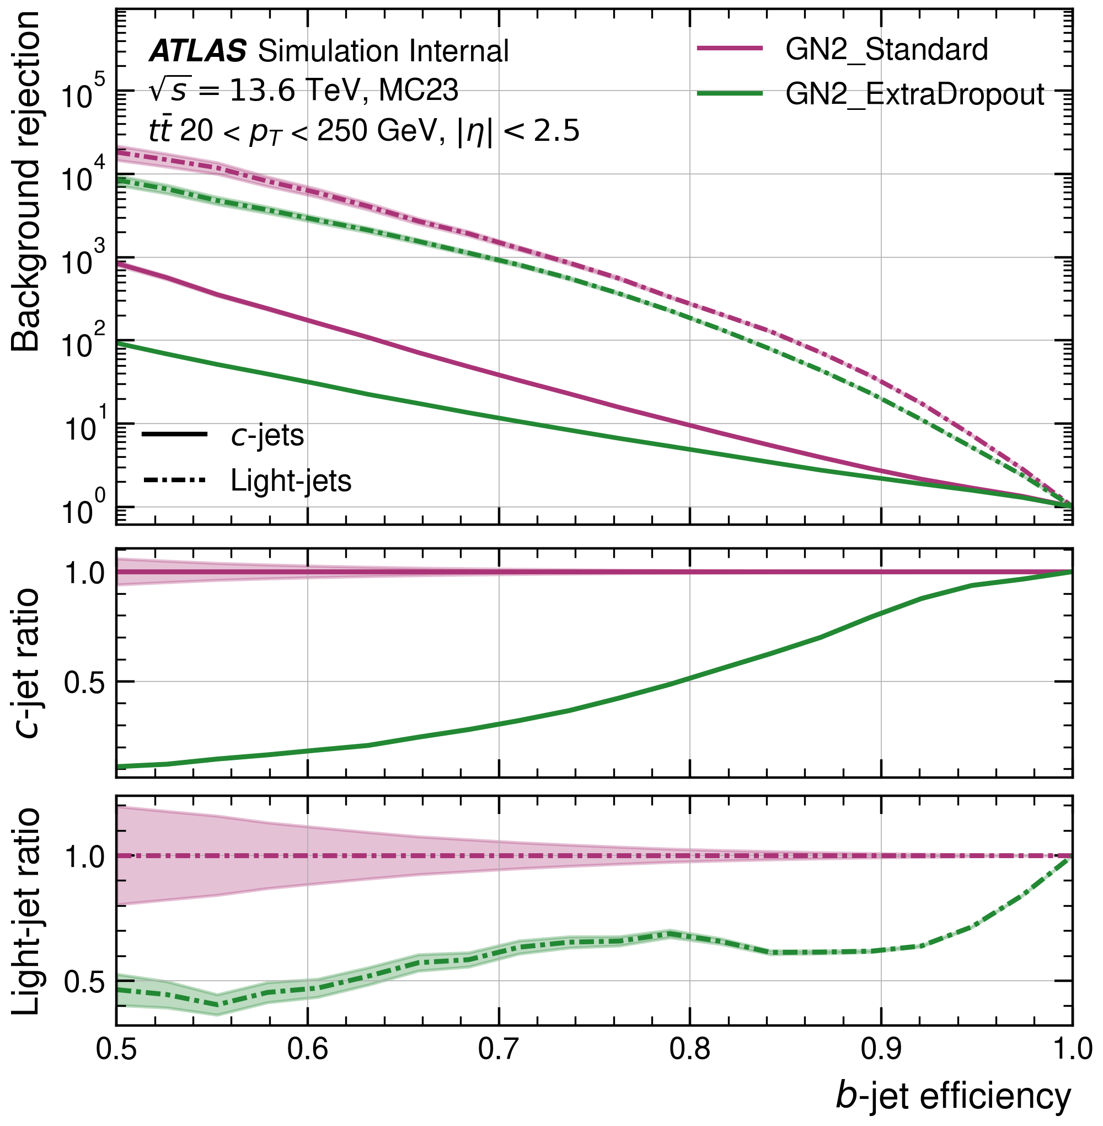
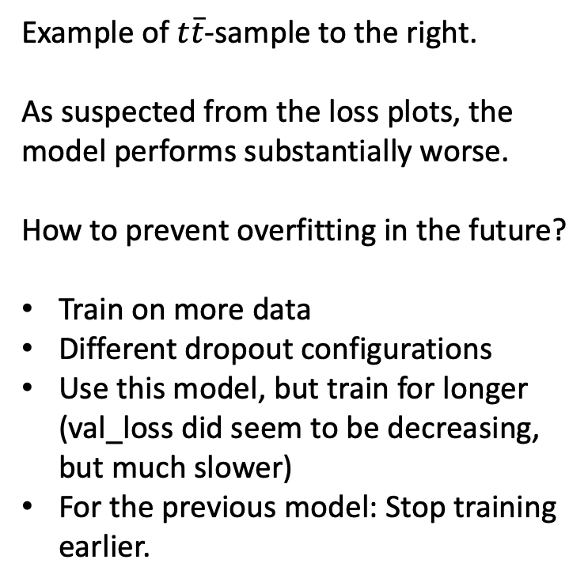
Network Overfitting: ROC results
Example of $t\overline{t}$-sample to the right.
As suspected from the loss plots, the model performs substantially worse.
How to prevent overfitting in the future?
Train on more data
Different dropout configurations
Use this model, but train for longer (val_loss did seem to be decreasing, but much slower)
For the previous model: Stop training earlier.

Slide 18
Issues & Next Steps
Find out why Nikita’s model performs differently:
Try a different training set, different dropout configurations
Try different ways of preventing overfitting:
Different dropout configurations in encoder / model.
Train with more data or train for longer with these added dropout layers.
Without the dropout layers, we can stop training earlier or increase the size of the training set.

